Slide 1
Fair Use & Asking for Permission
Sara Benson, Copyright Librarian

Slide 2
Agenda
1) Fair Use;
2) Asking for Permission
3) Q & A (but feel free to ask questions anytime in the chat)

Slide 3
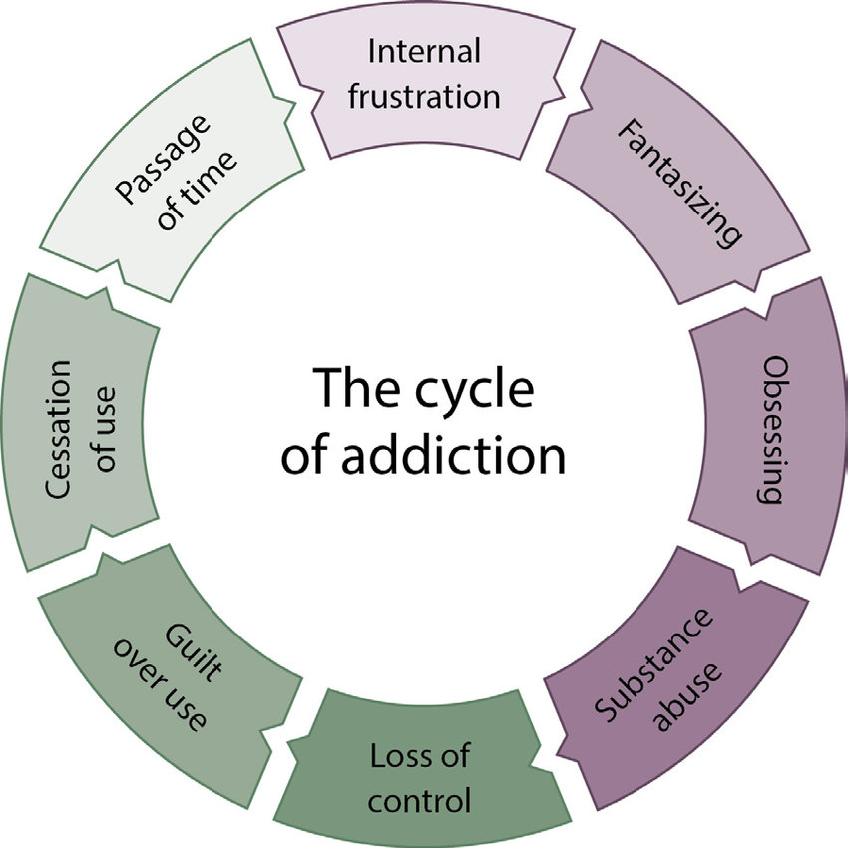
Why fair use?
Hypothetically speaking,
Let’s say you are creating your OER and you need a chart about the “cycle of addiction.” You’ve looked for public domain or openly licensed material, but you can’t locate anything helpful. You did find this, though:

Slide 4
You now have 2 options:
1. Decide that the use is a fair use and use the image without permission or
2. Contact the copyright owner to ask for permission
the image came from:“Cycle of Addiction,” by Recovery Connection, 2011, (http://www.recoveryconnection.org/connect/cycleaddiction/). Copyright 2016 by Lakeview Health.
You were able to locate an updated link: https://www.recoveryconnection.com/cycle-addiction/

Slide 5
Before you make this decision . . .
Let me ask you a question,
Do you think recovery connection is likely to grant you permission? Why or why not?
If you were to ask for permission, how would you do so?

Slide 6
Asking for permission
https://copyright.columbia.edu/basics/permissions-and-licensing.html
Locate the copyright owner (for published works, it is usually the publisher) and ask for a free non-exclusive license to:
- include the work in an open access textbook that will be available on the internet for free

Slide 7
Let’s assume…
You need that image, there is no real substitute for the image and you cannot locate the copyright owner.
That brings us to . . . Fair Use!
Before we delve too deeply into fair use, we must first note that it is a defense to copyright infringement.
As such, it always involves a risk assessment. What is the risk that you would be sued for using this chart/image/work in the OER?
If the risk seems high (a recent, popular artists, for instance), you might seek permission instead.

Slide 8
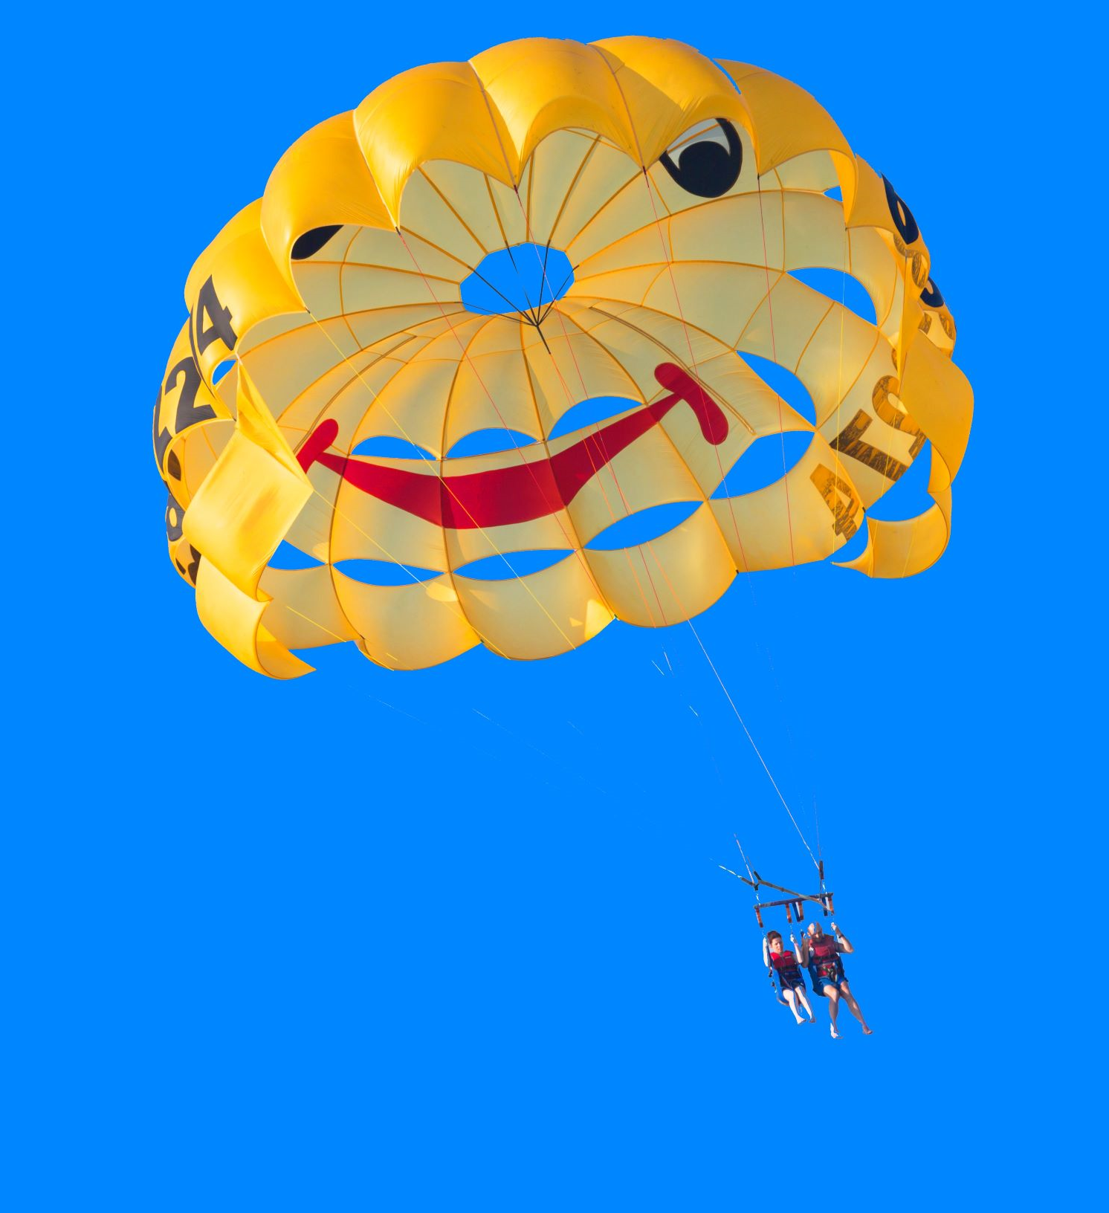
Limitation of Liability:
Section 504(c)(2)

Slide 9
17 U.S.C. Section 504(c)(2):
“The court shall remit statutory damages in any case where an infringer believed and had reasonable grounds for believing that his or her use of the copyrighted work was a fair use . . . if the infringer was:
an employee or agent of a nonprofit educational institution, library, or archives acting within the scope of his or her employment who . . . infringed by reproducing the work in copies or phonorecords”

Slide 10
Fair Use
(2)
Nature of the Work
(3)
Amount Used
(4)
Potential Effect on the Market Value
(1)
Purpose & Character

Slide 11
Purpose & Character of the Use
Commercial
Educational

Slide 12
Nature of the Underlying Work
Highly Creative
Factual/Historical

Slide 13
Amount Taken
Entire Work
Small Amount

Slide 14
Effect on Potential Market Value
Replaces Market Value
Different Market/No Market Impact

Slide 15
Transformative Works
A work that comments on the original with a new meaning or message . . .

Slide 16
Fair Use TOOLS
Fair use video
https://go.Illinois.edu/FairUseVideo
Check out Kenneth Crews’ Fair Use Checklist
https://copyright.columbia.edu/basics/fair-use/fair-use-checklist.html

Slide 17
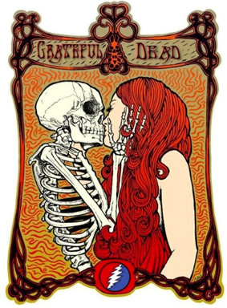
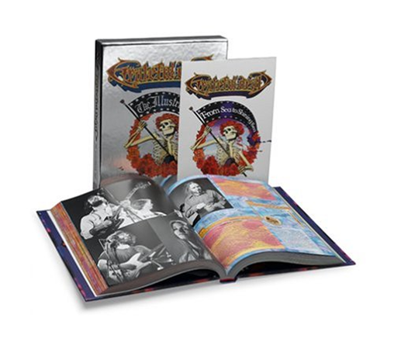
Transformative Use Example
Purpose of the original posters:
Advertise Concerts
Purpose of posters embedded in book:
Historical Context

Slide 18

Questions?

Slide 19
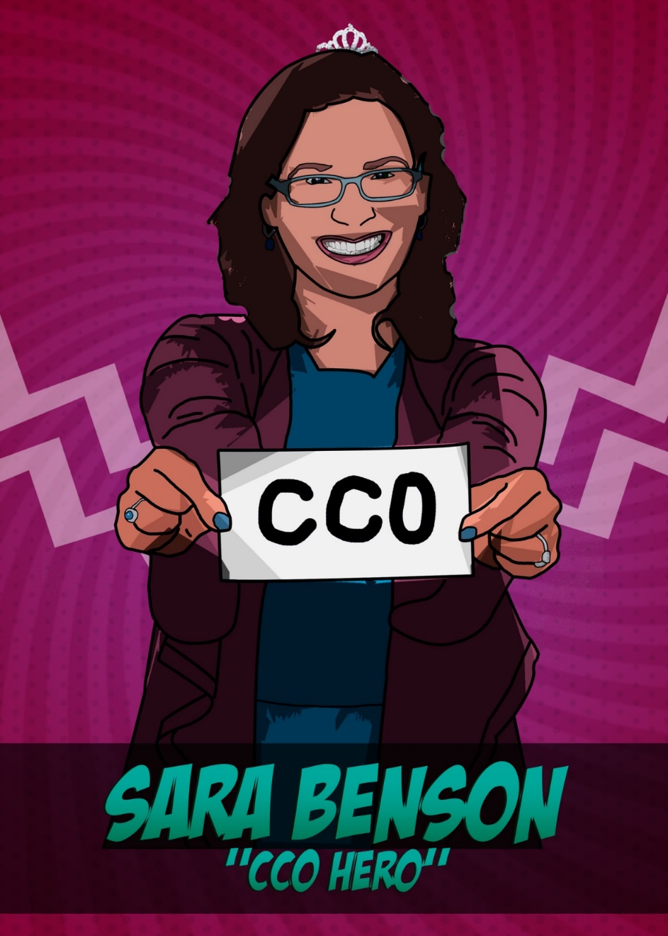
Questions?
Remember, you can always contact me:
srbenson@illinois.edu

